Slide 1

Website Development Project Management Portfolio
Project: LifeRoots Wellness Design
Project Manager: Femi Kwesi
Email: femi.Kwesi@gmail.com

Slide 2
LifeRoots Wellness Website Design
Title: LifeRoots Wellness Website Design (www.liferootswellness.com)
Subtitle: Project Management Plan
Tagline: “Quality Delivery of a seamless user experience on time and within budget"

Slide 3

01
Introduction & Agenda

Slide 4
Introduction & Agenda
This presentation covers the end-to-end strategy for the LifeRoots Wellness website design from vision to launch.
Agenda
Project Overview
Goals & KPIs
Scope Definition
Agile Methodology
Timeline & Milestones
Team Structure
Communication Plan
Risk Management
Budget
Next Steps

Slide 5
02
Project Overview

Slide 6
Project Goals
“Design LifeRoots Wellness website to increase increase conversion rate and create a modern brand identity”
Key Features:
Responsive Design for both mobile and desktop views
Online ordering system
Live agent Chat bot
Membership Portal
Blog
Shopping Cart
Payment Gateway

Slide 7
03
SMART Goals & KPI

Slide 8

Initial Scope Definition
SMART Goal | KPI | Target
Increase website & mobile ordering to 30% & 50% respectively in first 6 months | Conversion rate | 5.6% => 7.0%
Reduce bounce rate below 45% | Bounce Rate = (Total # of Single page visits/Total # OF SESSIONS)*100 | < OR = 45%
Achieve 90+ Page Speed Score | GTMetrix Score | Grade of “A” (> OR = 90)
Grow Traffic by 30% in Year 1 | Organic sessions Goggle analytics 4 | +30% YoY

Slide 9

04
Project Scope

Slide 10
SCOPE
In-Scope Deliverable
Responsive website for mobile and desktop devices.
Ordering and payment gateway integration.
Blog +Resource Center (5 articles).
SEO Optimization.
Shopping Cart.
Staff Training.
Out-of-Scope Deliverable
Mobile app development.
Social media marketing.
Ongoing content creation
CRM Integration.

Slide 11
05
Methodology

Slide 12

The Methodology used on this project is Agile
Why Agile ?
Flexibility for client feedback
Faster issue resolution
Adaptive
Testing, debugging and Development in Phases
Please see Appendix I for scrum workflow

Slide 13
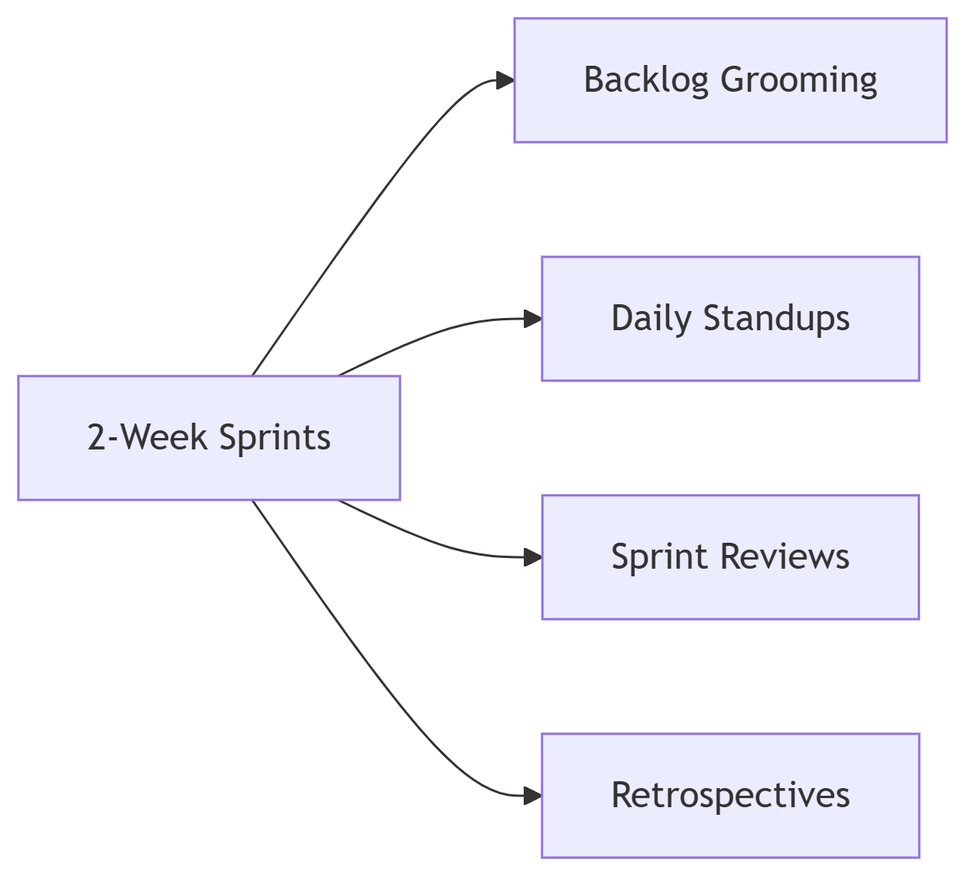
Sprint Structure Visual
Appendix I

Slide 14
06
Project Timeline

Slide 15
Timeline Breakdown
Please see Appendix II for Gantt Chart
Phase | Start Date | End Date | Duration | Deliverable
Discovery | Sep 01, 2024 | Sep 14, 2025 | 14 days | Stakeholders interview, Sitemap, Tech stack selection
Design | Sep 15, 2024 | Oct 05, 2025 | 21 days | Wireframes, UI Kit,
Development | Oct 06, 2025 | Nov 10, 2025 | 35 days | Ordering System, Responsive build, shopping cart
Testing | Nov 11, 2025 | Nov 24, 2025 | 14 days | Performance optimization, Test Reporting, Bug Fixes,
Lunch | Nov 25, 2025 | Dec 01, 2025 | 7 days | Livee website, Analytics, Training

Slide 16
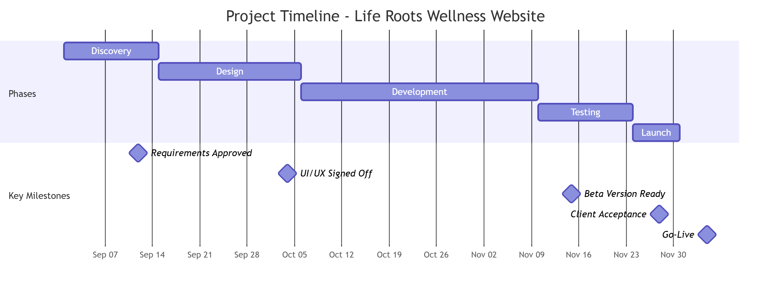
Timeline Breakdown Visual
Appendix II

Slide 17
07
Project Team & Roles

Slide 18
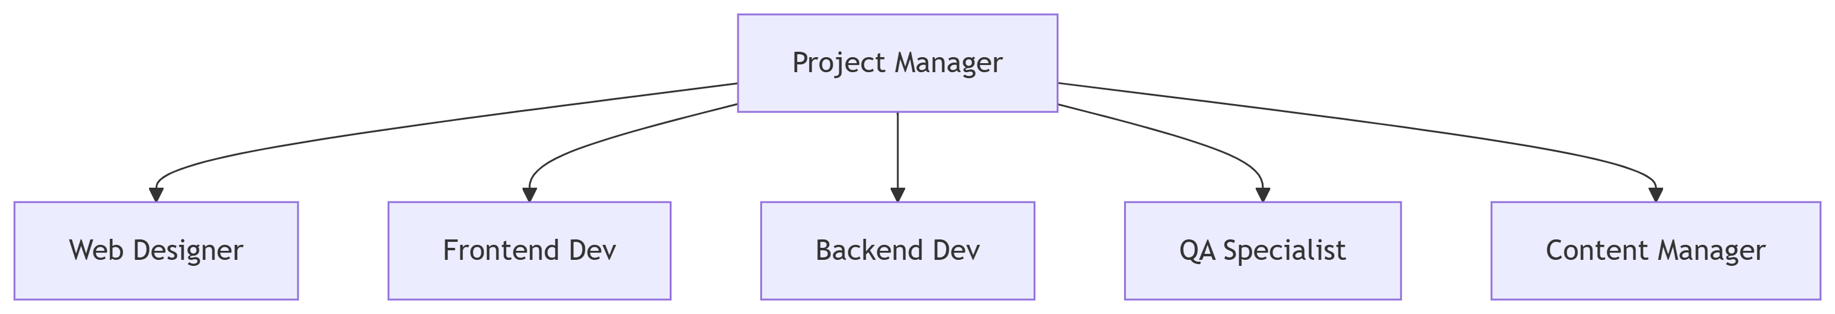
Team Structure
Human Resources: 6 team members @ $20/hrs./week each
Appendix III

Slide 19
08
Communication Plan

Slide 20
Communication Plan
Communication Matrix
Purpose | Tools | Frequency
Daily update | Slack | Daily
Task Tracking | Jira | Real-time
Client Reporting | Email & Power BI Dashboard | Bi-Weekly
Sprint Reviews | Zoom | Every 2 Weeks
Risk Alert | Microsoft Teams | As needed

Slide 21
09
Risk Management

Slide 22
Risk Management
Risk Matrix
Risk | Probability | Impact | Mitigation Strategy
Scope Creep | High | High | Change request process
Delayed Content Delivery | Medium | Medium | Buffer time & Pre-approved templates
Tech Debt Accumulation | Low | High | Code reviews every sprint
Vendor Delays (Payment Gateway) | Medium | High | Backup Provider (Square/PayPal)

Slide 23
Risk Response Table
Risk Matrix With Owner
Risk | Owner | Mitigation | Status
Scope Creep | PM | Change Control Process | On track
Vendors Delay | Lead Tech | Backup Provider | Monitoring

Slide 24
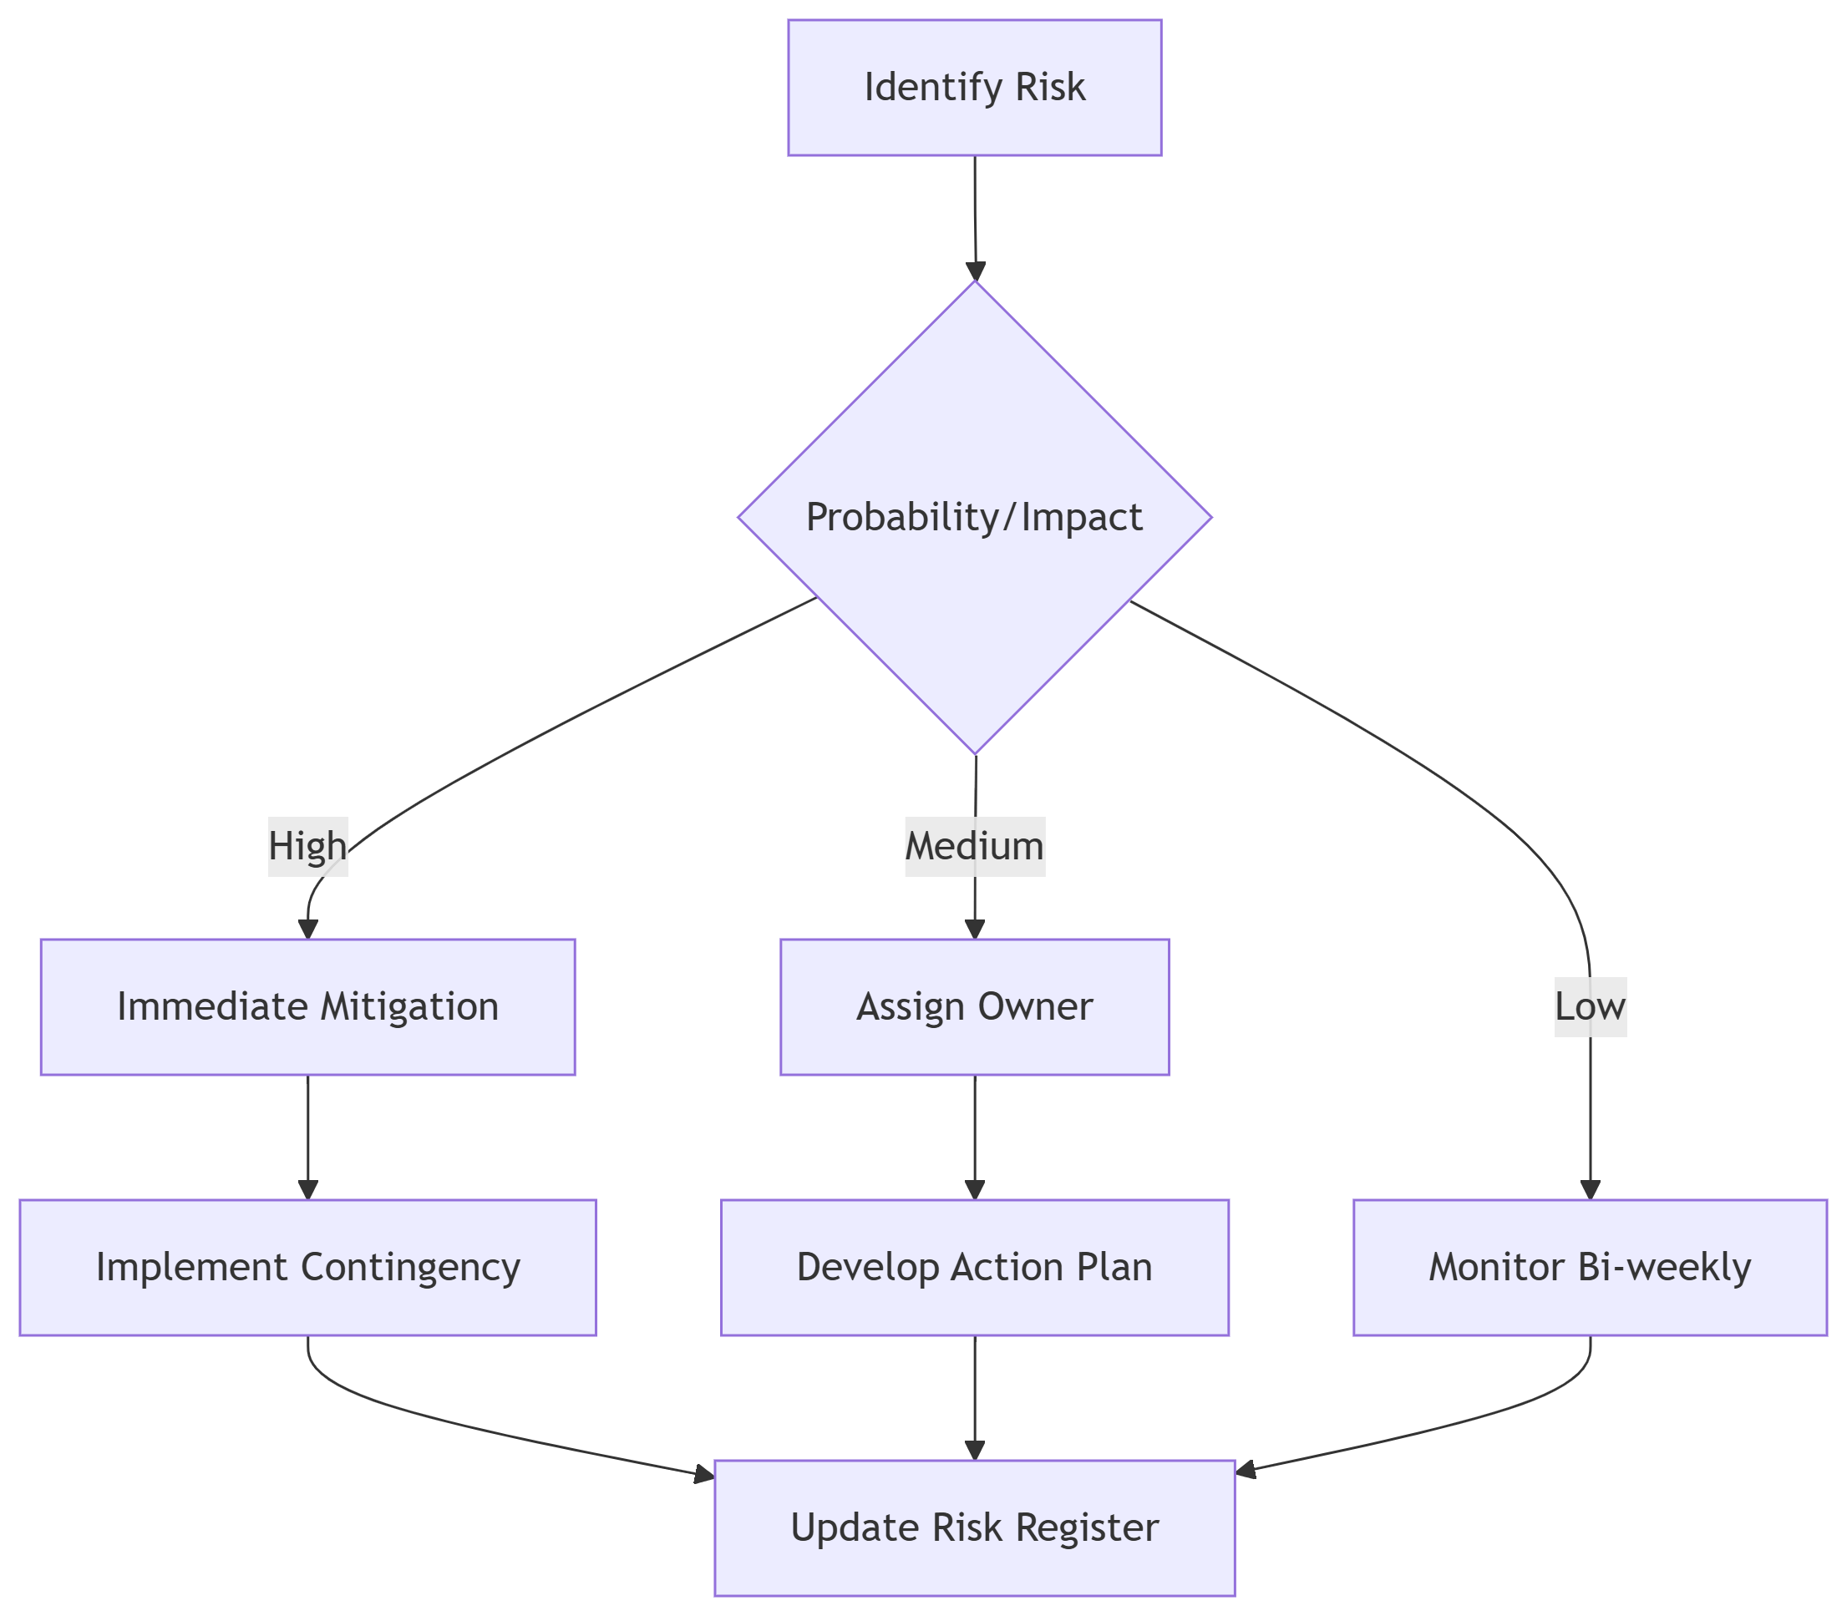
Risk Response Flowchart
Risk Response Process
Appendix IIII

Slide 25
10
Budget

Slide 26
Budget Matrix
Cost Breakdown
Category | Budget Allocation | Actual Spending | Variance | Variance % | Key Cost Drivers
Design | $7,200 (15%) | $7,800 | -$600 | -8.3% | UI/UX, Brand identity, Wireframes
Development | $21,600 (45%) | $20,100 | +$1,500 | +7.0% | CMS setup, API integrations
Content | $9,600 (20%) | $10,500 | -$900 | -9.4% | Blog posts, Resource library, SEO
Testing | $4,800 (10%) | $4,200 | +$600 | +12.5% | Automated tests, UAT sessions
Contingency | $4,800 (10%) | $2,600 | +$2,200 | +45.8% | Scope changes, Priority hotfixes
TOTAL | $48,000 | $45,200 | +$2,800 | +5.8%

Slide 27
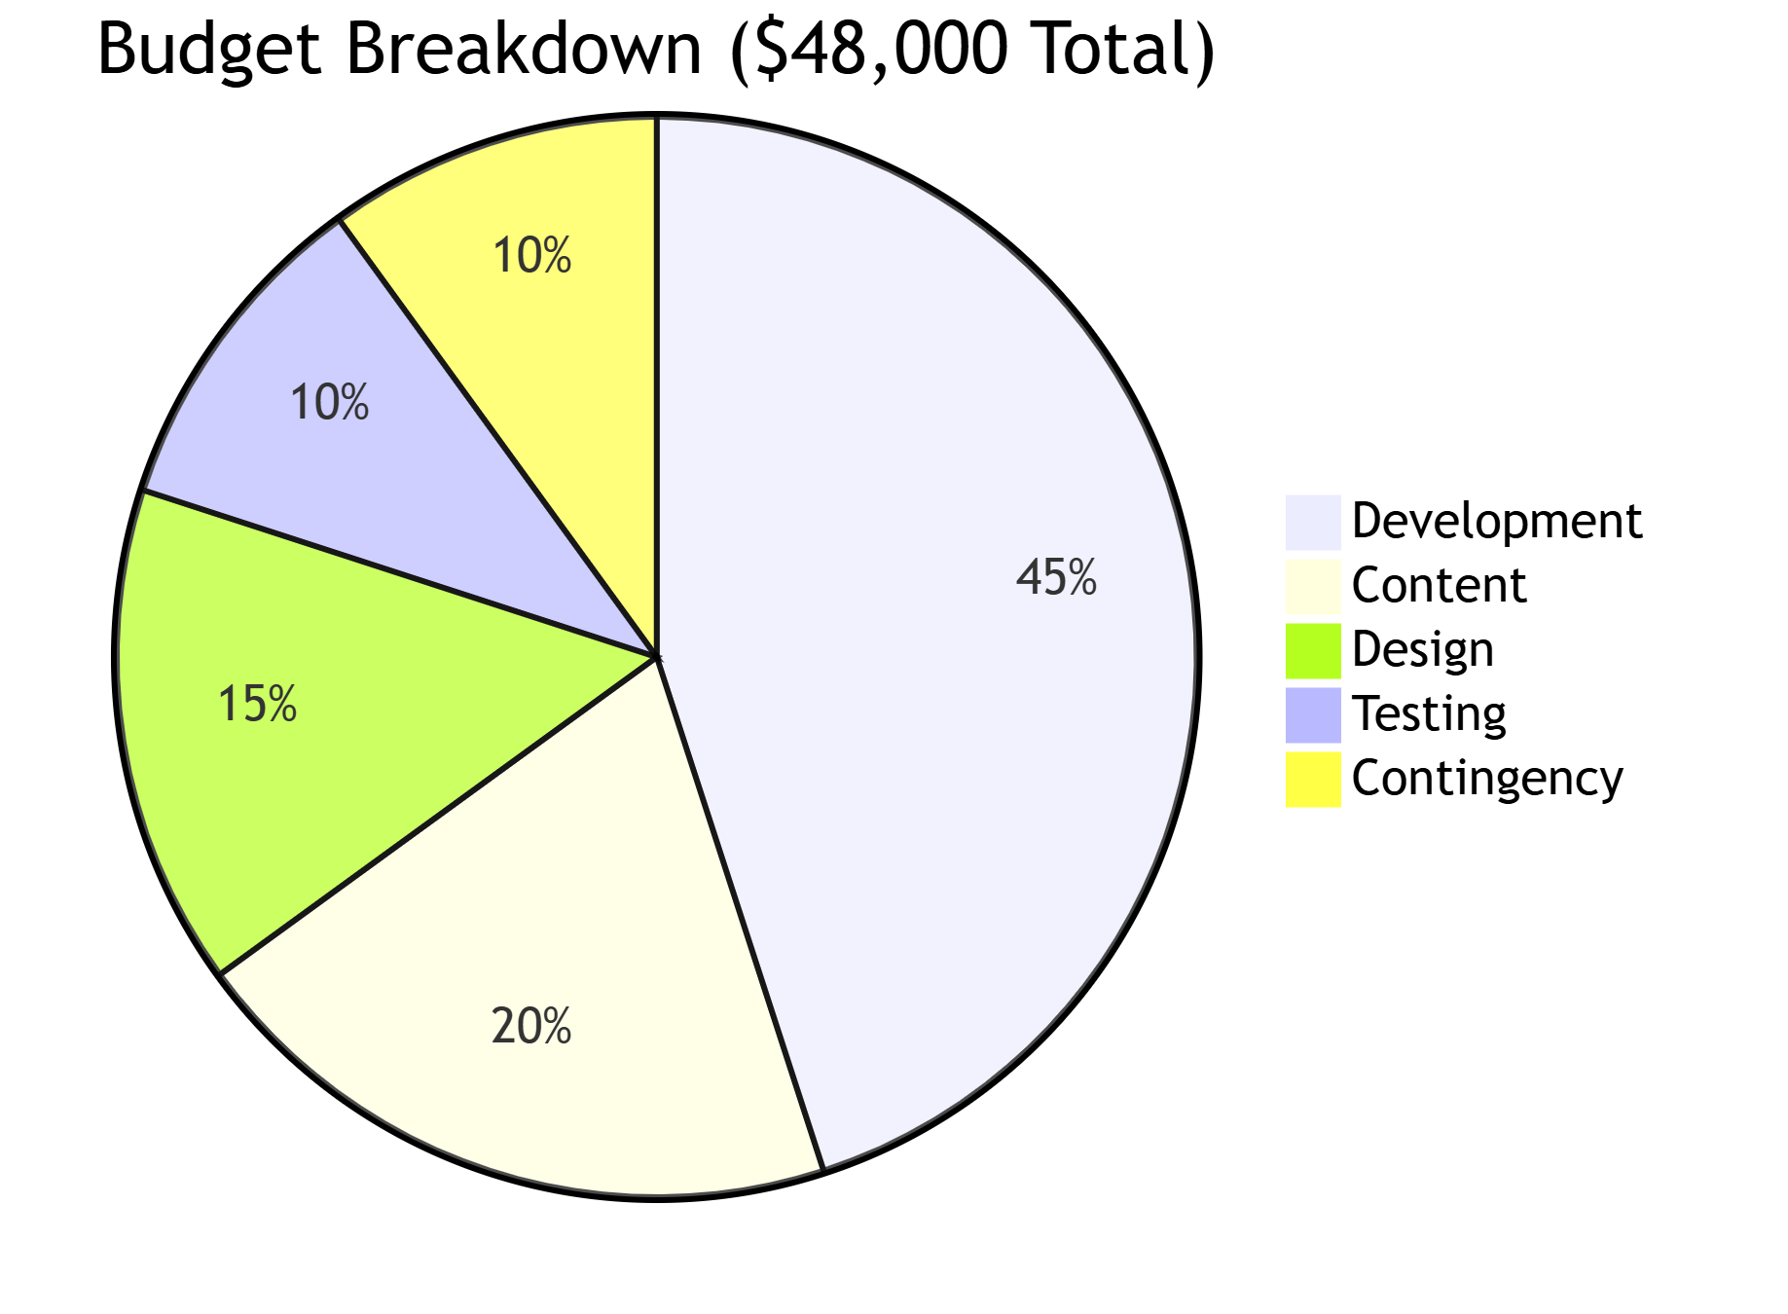
Budget Breakdown
Budget Breakdown Appendix V

Slide 28
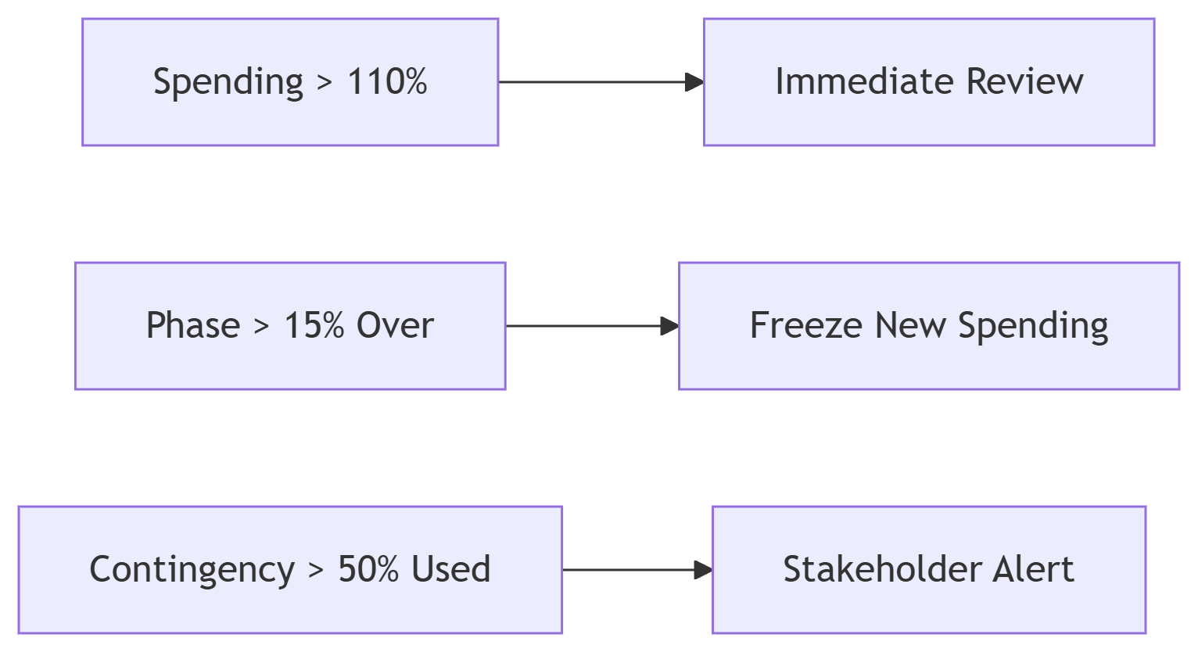
Budget Alert
Budget Trigger Decision Rule Appendix VI

Slide 29
11
Next Steps

Slide 30
Call To Action
Immediate Actions to Launch Success
Action Items | Owner | Deadline | Purpose
1. Sign Project Charter | Sponsor (CEO) | Aug 30, 2024 | Formalize scope, budget, and authority
2. Kick-off Meeting | Project Manager | Sep 1, 2024 | Align team on goals, roles, and processes
3. Sprint 0: Backlog Refinement | Lead Tech | Sep 1-5, 2024 | Finalize user stories, acceptance criteria
4. Design Workshop | UX Lead + Client | Sep 6, 2024 | Approve wireframes and brand guidelines
5. Dev Environment Setup | DevOps Engineer | Sep 3, 2024 | Configure GitHub, staging servers, CI/CD pipeline
6. Content Calendar Freeze | Marketing Manager | Sep 4, 2024 | Lock initial 20 blog topics and resources

Slide 31
Conclusions
The agile approach employed in this project facilitates adaptability and responsiveness to change, ensuring that the website development aligns closely with stakeholder expectations. Continuous engagement and prioritization of feedback improve overall project success, leading to a high-quality end product that meets the needs of Life Roots Wellness.

Slide 32

Thank you!
Do you have any questions?
Email: femi.kwesi@gmail.com
+00 000 000 000

